Slide 1
ARTEMIS
Pouria Moradpour

Slide 2
PROBLEM
Currently, the electricity used by DataCenters is more than the national energy consumption of Iran, and it’s expected to grow 8 times by 2030.
The ravening consumption
Usage of fossil fuels
By the year 2030, 50% of the electricity is still produced using fossil fuels.
THE LARGE NUMBER OF DUPLICATED DATA
Around 50% to 80% of the data stored in various organizations, is duplicated.
Given this knowledge, the only practical way would be to detect and delete the duplicated data.

Slide 3
ARTEMIS, the most CLEVER soloution TO THis PROBLEM
when installled on a server, artemis automatically detects data that seems to be duplicated and sends them to our server,if we made sure that they are similar, our client deletes and free up the server space for you.

Slide 4
HOW ARTEMIS WORKS
artemis client
client detects potentially similar data just based on file type/size to decrease the load on your server*
the only thing your users might detect is that their media has better quality!
Your user
Your server
our client now sends the potentially similar data to our servers so we can make sure wether or not they’re similar
Our server
* you can schedule data detection so your users won’t observe any performance loss

Slide 5
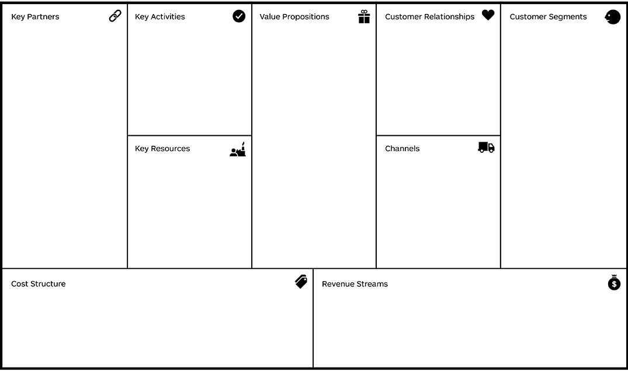
1-Data centers as customer or cloud sompution provider
2-Hardware companies
3-Environmental Organizations
Actively improving the client and AI
Freed up storage on the server which leads to:
1-cost savings due to less energy consumption
2-easier server management
3-cost savings due to less needed server storage
1-vairous discounts
For long term customers
2-24/7 customer suppport
1-organizations
2-social media
websites
3-data cneters
4-individuals*
1-Data scentists
2-Developers
3-Server to host our AI
4-Office for our engineers
1-Our website
2-Pages in social media
3-customer support

Slide 6
PRODUCT OVERVIEW
UNIQUE
Only product specifically dedicated to this niche market
FIRST TO MARKET
First beautifully designed product that's both stylish and functional
TESTED
Conducted testing with college students in the area
AUTHENTIC
Designed with the help and input of experts in the field

Slide 7
PRODUCT BENEFITS
Cool and stylish product
Areas for community connections
Online store and market swap

Slide 8
COMPANY OVERVIEW

Slide 9
BUSINESS MODEL
ABSTRACT
We based our research on market trends and social media
DESIGN
We believe people need more products specifically dedicated to this niche market
RESEARCH
Minimalist and easy to use

Slide 10
MARKET OVERVIEW
$3 Billion
$1 Billion
$2 Billion
Freedom to invent
Selectively inclusive market
Serviceable available market
Opportunity to build
Fully inclusive market
Total addressable market
Few competitors
Specifically targeted market
Serviceable obtainable market

Slide 11
Market comparison
$3B
$2B
$1B
Opportunity to build
Freedom to invent
Few competitors
Addressable market
Serviceable market
Obtainable market

Slide 12
OUR COMPETITION
CONTOSO
COMPETITORS
Our product is priced below that of other companies on the market
Design is simple and easy to use, compared to the complex designs of the competitors
Affordability is the main draw for our consumers to our product
Company A Product is more expensive
Companies B & C Product is expensive and inconvenient to use
Companies D & E Product is affordable, but inconvenient to use

Slide 13
Our competition
Convenient
Contoso
Competitor A
Affordable
Expensive
Competitor D
Competitor C
Competitor B
Competitor E
Inconvenient

Slide 14
Growth strategy
Feb 20XX
Roll out product to high profile or top-level participants to help establish the product
Mar 20XX
Release the product to the general public and monitor press release and social media accounts
Oct 20XX
Gather feedback and adjust product design as necessary

Slide 15
TWO-YEAR ACTION PLAN
DRAFT BLUEPRINTS
GATHER FEEDBACK
DELIVER TO CLIENT
20XX
JAN
FEB
MAR
APR
MAY
JUN
JUL
AUG
SEP
OCT
NOV
DEC
20XX
JAN
FEB
MAR
APR
MAY
JUN
JUL
AUG
SEP
OCT
NOV
DEC
RUN FOCUS GROUPS
TEST DESIGN
LAUNCH DESIGN

Slide 16
FINANCIALS
 | Year 1 | Year 2 | Year 3
INCOME
Users | 50,000 | 400,000 | 1,600,000
Sales | 500,000 | 4,000,000 | 16,000,000
Average price per sale | 75 | 80 | 90
Revenue @ 15% | 5,625,000 | 48,000,000 | 216,000,000
GROSS PROFIT | 5,625,000 | 48,000,000 | 216,000,000
Expenses
Sales & marketing | 5,062,500 | 38,400,000 | 151,200,000 | 70%
Customer service | 1,687,500 | 9,600,000 | 21,600,000 | 10%
Product development | 562,500 | 2,400,000 | 10,800,000 | 5%
Research | 281,250 | 2,400,000 | 4,320,000 | 2%
TOTAL EXPENSES | 7,593,750 | 52,800,000 | 187,920,000

Slide 17
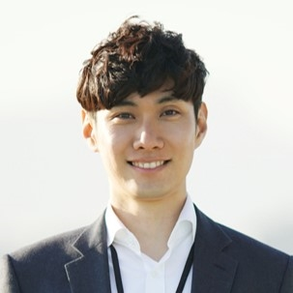
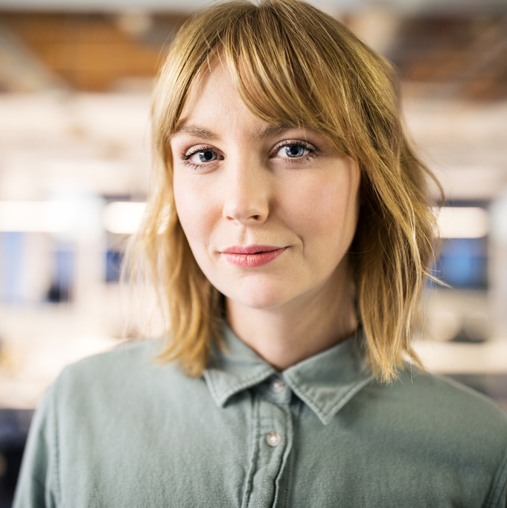


MEET THE TEAM
TAKUMA HAYASHI​
MIRJAM NILSSON​
FLORA BERGGREN​
RAJESH SANTOSHI​
President
Chief Executive Officer
Chief Operations Officer
VP Marketing

Slide 18
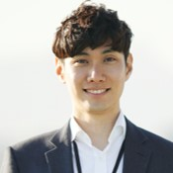







MEET THE TEAM
TAKUMA HAYASHI
MIRJAM NILSSON​
FLORA BERGGREN​
RAJESH SANTOSHI
President
Chief Executive Officer
Chief Operations Officer
VP Marketing
GRAHAM BARNES
ROWAN MURPHY
ELIZABETH MOORE
ROBIN KLINE
VP Product
SEO Strategist
Product Designer
Content Developer

Slide 19
SUMMARY
At Contoso, we believe in giving 110%. By using our next-generation data architecture, we help organizations virtually manage agile workflows. We thrive because of our market knowledge and great team behind our product. As our CEO says, "Efficiencies will come from proactively transforming how we do business.”

Slide 20
THANK YOU
Mirjam Nilsson​
206-555-0146
mirjam@contoso.com
www.contoso.com

